Slide 1
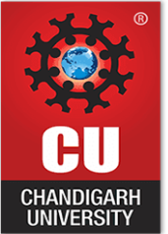
UNIVERSITY INSTITUTE OF COMPUTING
Agile Methodology
(24CAT-656)

Slide 2
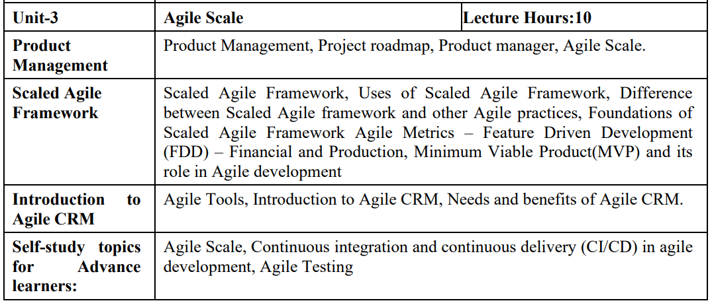
SYLLABUS
2

Slide 3
CONTENT OF THE SYLLABUS
TEXT BOOKS
T1 David J. Anderson and Eli Schragenheim, Agile Management for Software Engineering: Applying the Theory of Constraints for Business Results, Prentice Hall, 2003.
T2 Hazza and Dubinsky, Agile Software Engineering, Series: Undergraduate Topics in Computer Science, Springer, 2009.
T3 Agile Software Development Ecosystems by Jim Highsmith, Addison-Wesley 2002, ISBN 0201760436.
REFERENCES
R1 Craig Larman, Agile and Iterative Development: A Managers Guide, Addison-Wesley, 2004.
R2 Kevin C. Desouza, Agile Information Systems: Conceptualization, Construction, and Management, Butterworth-Heinemann, 2007.
3

Slide 4
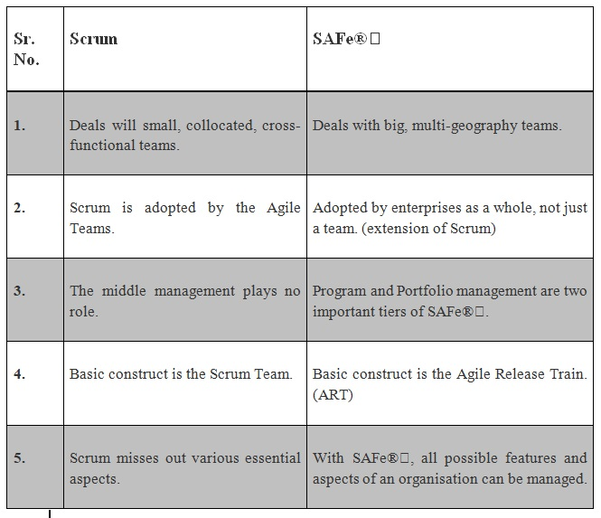
Differences between Scrum and SAFe®
4

Slide 5
Difference between Agile and SAFe Agile
1. Principles & Strategy:
Agile is an iterative method used for developing a product that focuses on the continuous delivery of tasks assigned. It is dependent on cross-functional teams, sprints (set of stories), and specific roles that help in delivering the assignment. Agile is mainly developed for a small team of ten or fewer people. SAFe, on the other hand, is an agile framework for an enterprise which is not limited to smaller teams and guides enterprises in scaling lean and agile practices.
5

Slide 6
Difference between Agile and SAFe Agile
2. Benefits Received:
Agile provides project teams, sponsors, leaders, and customers many project-specific benefits, including -
1. Reduced waste through minimisation of resources
2. Faster turnaround time
3. Optimised development processes
4. Increased focus on specific customer needs
5. Increased frequency of collaboration and feedback
6

Slide 7
Difference between Agile and SAFe Agile
Whereas, multiple business benefits provided by SAFe are as follows:
1. Quicker codification of agile practices
2. Provides a practical framework for practitioners as they can directly write processes without waiting for process development training sessions
3. Leads to about 50% reduction in defects and a 35% increase in productivity
4. Time-to-market is significantly increased (50% approx.)
7

Slide 8
Difference between Agile and SAFe Agile
3. Core Values:
The SAFe portfolio works on four core values of alignment, built-in-quality, transparency, and program execution.
Likewise, the Agile manifesto is also based on the following four values:
1. Individuals and interactions over processes and tools
2. Working software over comprehensive documentation
3. Customer collaboration over contract negotiation
4. Responding to change over following a plan
8

Slide 9
Scaled Agile
Agile wasn’t originally conceived with scale in mind. The goal was unschackling developers and engineers, empowering them to tackle implementation independently using their own best judgment, incorporating learnings from one iteration into the next.
That unfettered independence doesn’t work as well when there are multiple teams off doing their own thing, particularly when their individual projects must interoperate, share a common interface, rely on a shared architecture, etc. Things can quickly escalate into a free-for-all.
9

Slide 10
Scaled Agile
Therefore, leveraging the advantages of Agile while recognizing the need for coordination and compatibility demands more structure, organization, and oversight. Agile at scale must have more rules and controls to ensure the finished product not only functions but works seamlessly across various sub-components, and that product suites look and act like they were built by the same company.
The various Microsoft Office apps, for example, all perform their individual functions well, but what makes the suite even more successful is how seamlessly users can move from one program to the next with a limited learning curve thanks to a common UX. If the Word team and the Excel team operated 100% independently, it wouldn’t be long until each one behaved quite differently.
10

Slide 11
Scaled Agile
Scaled Agile provides that layer of management and coordination to build complex solutions that are too big and complicated for a single Scrum team to tackle. This may be driven by urgency to get a solution to market, or simply because the product itself is too large and sophisticated.
Scaled Agile also creates a more predictable release schedule. Because of the coordination required, it’s clearer when certain projects, products, components, and features will ship, enabling enterprise software companies to make customer commitments and line up sales, marketing, operations, and customer service to support these launches.
11

Slide 12
SAFe Versus Scrum
SAFe and Scrum aren’t at odds with eachother. Rarely does someone pick one over the other. It’s more a question of environment and objectives for implementing Agile principles.
Scrum is a highly efficient way of delivering a project using a small team. It’s flexible, transparent, and light on overhead. It requires lots of communication between those small team members to operate at a high level.
Scrum is not, however, a great way to run a large organization with multiple products and projects being run simultaneously. It’s the scrappy, Special Ops approach to quickly reaching discrete goals through iterative development.
Managing the complexities, interdependencies, and multiple teams required to operate at scale necessitates a more robust structure to avoid everything devolving into chaos. It’s stepping up from a niche boutique to assembly-line scale coordination.
12

Slide 13
SAFe Versus Scrum
SAFe’s Agile Release Train doesn’t run on time without a middle-management level of oversight conducted at the program level, with multiple products or projects under that umbrella. And, at the highest levels of the organization, an even broader scope of oversight falls within specific portfolios.
While SAFe does limit the dynamism of Agile’s potential by requiring more planning and rigidity, it does so for the right reasons. The individual pieces of the puzzle must ultimately fit together and larger organizations need a greater degree of standardization to enable resource flexibility and component compatibility.
13

Slide 14
What are the Strengths and Weaknesses of SAFe?
SAFe’s strengths include:
Helps cross-functional teams collaborate more effectively
Helps organizations achieve greater transparency
Aligns all aspects of a project to the broader business goals
SAFe’s weaknesses include:
Firstly, some believe the framework is not pure agile, because requires too much upfront planning and process definition
Also takes more of a top-down approach rather than a team-based approach
14

Slide 15
Should You Use the Scaled Agile Framework?
SAFe is most-popular among enterprise organizations as many of its facets focus on eliminating the common challenges teams face when scaling agile.
In other words, if your company is just beginning to transition to agile, SAFe might be a viable option to bridge that gap because of its more prescriptive approach than, say, Disciplined Agile (DA), which offers more flexibility and customization but also requires an organization fully understand the agile philosophy already.
15

Slide 16
Should You Use the Scaled Agile Framework?
But, it is worth noting, however, that SAFe’s top-down approach to decision making and project management can undermine some of the core agile principles—such as collective ownership, adaptiveness, and less fixed roles—that might have attracted your team to agile in the first place.
16

Slide 17
THANK YOU
For Queries:- ramanjeetsingh.uic@cumail.in

